Slide 1
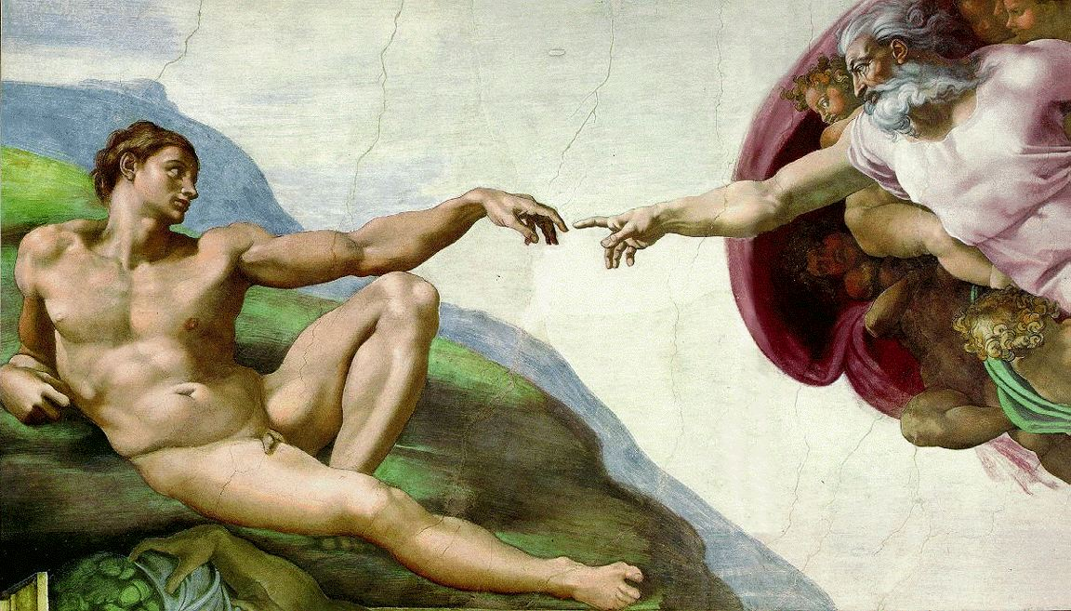
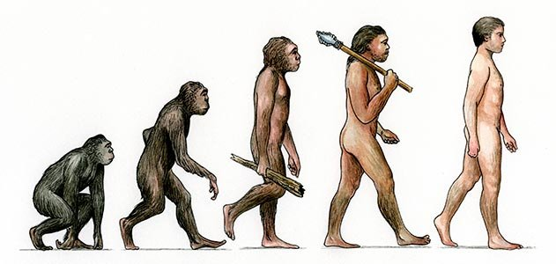
Creation and Evolution, Chance and Purpose: A Catholic Perspective
Notes:
What is Creation?
A Catholic perspective
Evolution
Science of evolution vs philosophical claims made about evolution
Overview of Church Teaching on Evolution
Theological and philosophical questions about evolution
Order and Purpose in Evolution?
Human Origins and Original Sin

Slide 2
The Catholic Understanding of Creation
“Nothing exists that does not owe its existence to God the Creator.” CCC 338

Slide 3
The Catholic Understanding of Creation: Three Points
1) The Universe owes its existence to God: CCC 338
Universe is ordered
Reveals God
2) We owe our existence to God CCC343
Deliberately intended to create us
It was a particular event
3) God created man in his image: CCC 355
We are set apart from the rest of creation
We have an earthly body
Notes:
The order and harmony of the created world results from the diversity of beings and from the relationships which exist among them.

Slide 4
Creation and Evolution, Chance and Purpose: A Catholic Perspective
Notes:
What is Creation?
A Catholic perspective
Evolution
Science of evolution vs philosophical claims made about evolution
Overview of Church Teaching on Evolution
Theological and philosophical questions about evolution
Order and Purpose in Evolution?
Human Origins and Original Sin

Slide 5
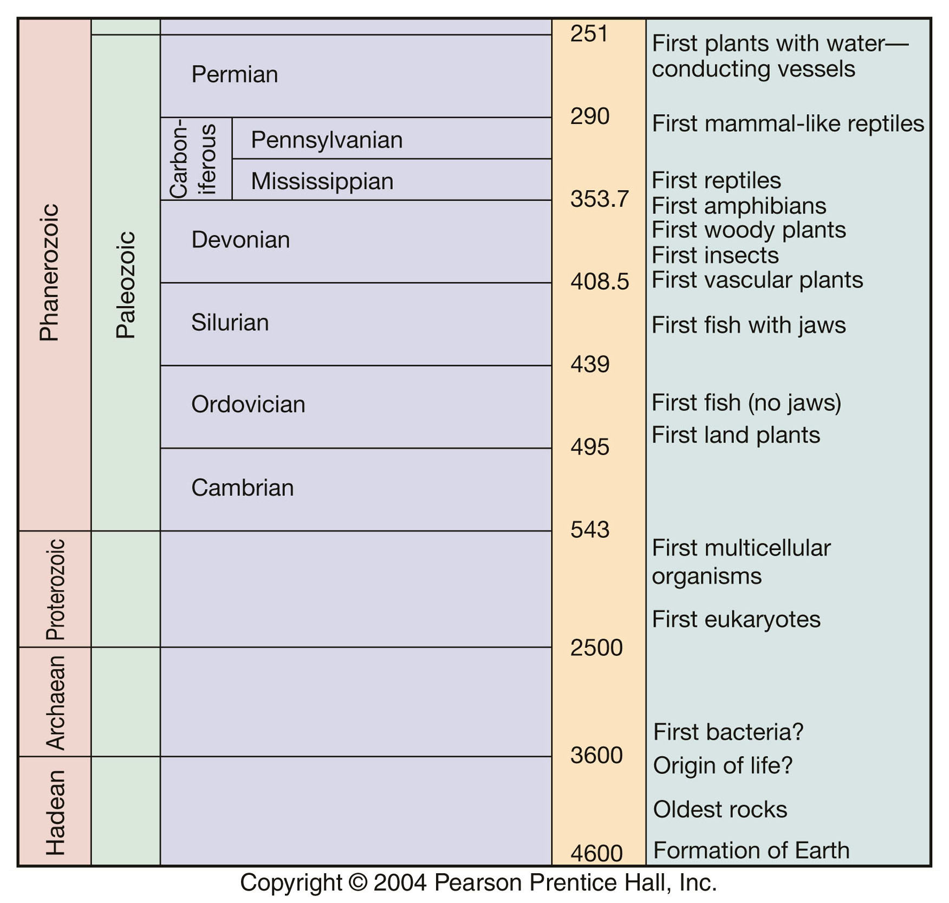
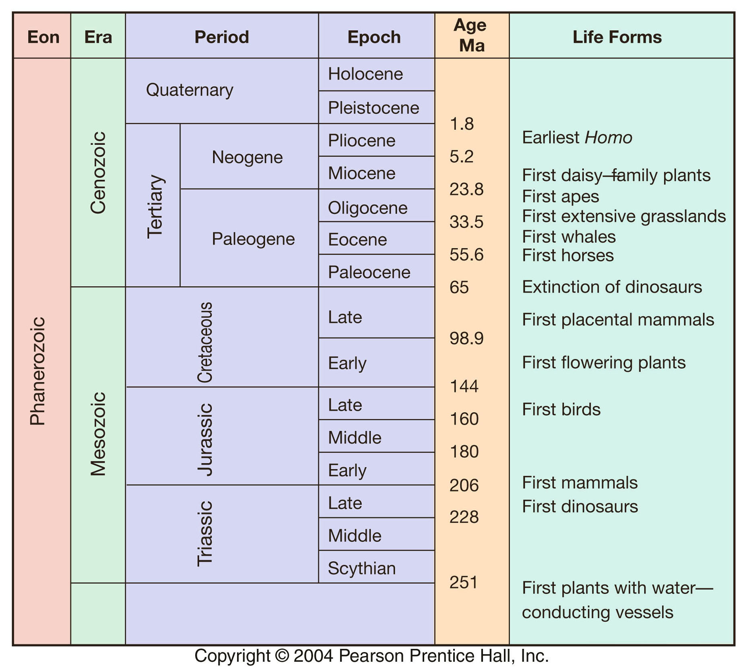
What is Evolution?
Scientific usage:
A systematic study of the physical/material world gained through observation and experimentation
Philosophical usage:
Science of evolution is used to advocate a philosophical position
Notes:
change in phenotype can precede change in genotype^{[4]}
changes in phenotype are predominantly positive, rather than neutral (see: neutral theory of molecular evolution)
changes in phenotype are induced in many organisms, rather than one organism^{[4]}
revolutionary change in phenotype can occur through mutation, facilitated variation^{[4]} or threshold events^{[39][55]}
repeated evolution in isolated populations can be by convergent evolution or developmental bias^{[4][31]}
adaptation can be caused by natural selection, environmental induction, non-genetic inheritance, learning and cultural transmission (see: Baldwin effect, meme, transgenerational epigenetic inheritance, ecological inheritance, non-Mendelian inheritance)^{[4]}
rapid evolution can result from simultaneous induction, natural selection^{[4]} and developmental dynamics^{[56]}
biodiversity can be affected by features of developmental systems such as differences in evolvability^{[4]}
heritable variation is directed towards variants that are adaptive and integrated with phenotype^{[4]}
niche construction is biased towards environmental changes that suit the constructor's phenotype, or that of its descendants, and enhance their fitness^{[57]}
kin selection^{[3]}
multilevel selection^{[4]}
self-organization^{[40][58]}

Slide 6
Evolution: Scientific Meanings
These are limited to offering observations/explanations for material/physical processes
Darwinian Evolution
Common Descent
Historical Evolution
Notes:
change in phenotype can precede change in genotype^{[4]}
changes in phenotype are predominantly positive, rather than neutral (see: neutral theory of molecular evolution)
changes in phenotype are induced in many organisms, rather than one organism^{[4]}
revolutionary change in phenotype can occur through mutation, facilitated variation^{[4]} or threshold events^{[39][55]}
repeated evolution in isolated populations can be by convergent evolution or developmental bias^{[4][31]}
adaptation can be caused by natural selection, environmental induction, non-genetic inheritance, learning and cultural transmission (see: Baldwin effect, meme, transgenerational epigenetic inheritance, ecological inheritance, non-Mendelian inheritance)^{[4]}
rapid evolution can result from simultaneous induction, natural selection^{[4]} and developmental dynamics^{[56]}
biodiversity can be affected by features of developmental systems such as differences in evolvability^{[4]}
heritable variation is directed towards variants that are adaptive and integrated with phenotype^{[4]}
niche construction is biased towards environmental changes that suit the constructor's phenotype, or that of its descendants, and enhance their fitness^{[57]}
kin selection^{[3]}
multilevel selection^{[4]}
self-organization^{[40][58]}

Slide 7
Evolution: A Philosophical Position
Scientific Atheism
Evolution demonstrates that human person is nothing more than the accidental product of a blind process
Denies the reality of the immaterial aspect of man
Darwinian Evolution
Common Descent
Historical Evolution
Notes:
change in phenotype can precede change in genotype^{[4]}
changes in phenotype are predominantly positive, rather than neutral (see: neutral theory of molecular evolution)
changes in phenotype are induced in many organisms, rather than one organism^{[4]}
revolutionary change in phenotype can occur through mutation, facilitated variation^{[4]} or threshold events^{[39][55]}
repeated evolution in isolated populations can be by convergent evolution or developmental bias^{[4][31]}
adaptation can be caused by natural selection, environmental induction, non-genetic inheritance, learning and cultural transmission (see: Baldwin effect, meme, transgenerational epigenetic inheritance, ecological inheritance, non-Mendelian inheritance)^{[4]}
rapid evolution can result from simultaneous induction, natural selection^{[4]} and developmental dynamics^{[56]}
biodiversity can be affected by features of developmental systems such as differences in evolvability^{[4]}
heritable variation is directed towards variants that are adaptive and integrated with phenotype^{[4]}
niche construction is biased towards environmental changes that suit the constructor's phenotype, or that of its descendants, and enhance their fitness^{[57]}
kin selection^{[3]}
multilevel selection^{[4]}
self-organization^{[40][58]}

Slide 8
What Does the Church Say About Evolution?
There is no official Church teaching on the scientific theory of evolution
Church has stated that evolution, as a scientific theory, is worth investigating.
However, it consistently condemns cases in which theories of evolution masquerade as bad philosophy

Slide 9
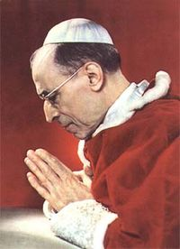
“The Teaching Authority of the Church does not forbid that, in conformity with the present state of human sciences and sacred theology, research and discussions, on the part of men experienced in both fields, take place with regard to the doctrine of evolution, insofar as it inquiries into the origin of the human body as coming from pre-existent and living matter.” Pope Pius XII (Humani Generis, 1950)
Notes:
366 The Church teaches that every spiritual soul is created immediately by God - it is not "produced" by the parents - and also that it is immortal: it does not perish when it separates from the body at death, and it will be reunited with the body at the final Resurrection.²³⁵
“The Church teaches that every spiritual soul
is created immediately by God – it is not
“produced” by the parents” CCC366

Slide 10
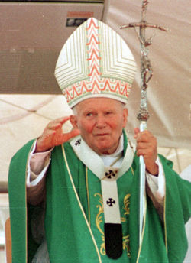
“Today, almost half a century after the publication of the Encyclical [Humani generis, 1950], new knowledge has led to the recognition of more than a hypothesis in the theory of evolution.” St. John Paul II (Address to the Pontifical Academy of Sciences, 1996)
“..the theories of evolution which, because of the philosophies which inspire them, regard the spirit either as emerging from the forces of living matter, or as a simple epiphenomenon of that matter, are incompatible with the truth about man.”

Slide 11
“We cannot say: creation or evolution, inasmuch as these things correspond to two different realities. [The Genesis creation account] does not in fact explain how human persons come to be but rather what they are. .. And, vice versa, the theory of evolution seeks to understand and describe biological developments. To that extent we are faced here with two complementary—rather than mutually exclusive—realities.”
Pope Benedict XVI
“In the Beginning…”

Slide 12
Evolution and Creation as Complimentary
Evolutionary Account (Scientific)
Provides an explanation of how man’s material body emerged
Creation Account (Theology and Philosophy)
Provides an account of man’s value and worth
Notes:
The canine morphology that Ardipithecus and Sahelanthropus share
with later hominins is, perhaps, the most convincing evidence to support
their hominin status, but it is important to recognize that during the late
Miocene a number of Eurasian hominids (for example, Oreopithecus,
Ouranopithecus and Gigantopithecus) also developed small canines in
conjunction with reduced canine–premolar honing, presumably as a
result of parallel shifts in dietary behaviour in response to changing
ecological conditions.

Slide 13
Creation and Evolution, Chance and Purpose: A Catholic Perspective
Notes:
What is Creation?
A Catholic perspective
Evolution
Science of evolution vs philosophical claims made about evolution
Overview of Church Teaching on Evolution
Theological and philosophical questions about evolution
Order and Purpose in Evolution?
Human Origins and Original Sin

Slide 14
Evolution Has no Plan or Purpose
Argument: Evolution must be without a plan or purpose (no loving Creator who stands behind it) because its core mechanism is the natural selection of mutations that occur via chance (randomness).
Notes:
Can we speak of a universal biochemistry? Are there viable alternatives, and do “decisions” at key points then pre-determine further evolutionary stages in a particular direction? If these “key points” do exist, how do we define them? Are there genuine “frozen accidents” of evolution? Are pre-biotic circumstances incidental, or central, to subsequent organic development? How do levels of complexity emerge, and are they inevitable? Can we envisage other types of complexity? Will any biosphere show features such as endosymbiosis, multicellularity (or indeed cells!), communication (including quorum sensing), ecological guilds, nervous systems, and societies? If so, are those on Earth of any wider significance? Can we properly define evolutionary constraints? Can we envisage genuine alternatives at any level of evolution? Do “decisions” at one level predispose evolution in particular directions? What is the role of evolutionary incumbency? Is it correct that any biosphere will be utterly unlike any other that exists? In other words, how are biological “hyperspaces” to be “navigated”? What does convergence tell us about evolution? How do we define convergence? How variable are evolutionary trajectories leading to similar outcomes? Is convergence at molecular levels significant? Are developmental pathways convergent? Does convergence at one biological level depend on convergence at another? How do we explain integrated adaptive units? Is symmorphosis a viable concept? Does concerted convergence have a general applicability? Is specialization always a “dead-end”? Are there general rules concerning the invasion of new adaptive zones? What do we mean by intelligence? Is intelligence an inevitable product of evolution? How many alternatives are there? Can we define an intelligence “space”? Is intelligence necessarily neural? Do particular intelligences have necessary co-adaptations? Is there a deep structure to biological systems? If there is, or potentially if we have reason to believe so, where do we go from here? Is a landscape metaphor redundant? How can we model hyper-dimensional biological spaces? Are there inevitable end-points? Are there optimal systems?

Slide 15
Issue #1) Integrating chance and Providence
Experience is riddled through with chance events
"It makes no difference... whether the appearance of Homo sapiens is the inevitable result of a steady process of complexification stretching out over billions of years, or whether on the contrary it comes through a series of coincidences that would have made it entirely unpredictable from the (causal) human standpoint. Either way, the outcome is God's making, and from the biblical standpoint could be properly said to be God's plan. Terms like 'plan' obviously shift meaning when the element of time is absent. For God to plan is for the outcome to occur. There is no interval between the decision and the completion.”
Ernan McMullin
Notes:
Can we speak of a universal biochemistry? Are there viable alternatives, and do “decisions” at key points then pre-determine further evolutionary stages in a particular direction? If these “key points” do exist, how do we define them? Are there genuine “frozen accidents” of evolution? Are pre-biotic circumstances incidental, or central, to subsequent organic development? How do levels of complexity emerge, and are they inevitable? Can we envisage other types of complexity? Will any biosphere show features such as endosymbiosis, multicellularity (or indeed cells!), communication (including quorum sensing), ecological guilds, nervous systems, and societies? If so, are those on Earth of any wider significance? Can we properly define evolutionary constraints? Can we envisage genuine alternatives at any level of evolution? Do “decisions” at one level predispose evolution in particular directions? What is the role of evolutionary incumbency? Is it correct that any biosphere will be utterly unlike any other that exists? In other words, how are biological “hyperspaces” to be “navigated”? What does convergence tell us about evolution? How do we define convergence? How variable are evolutionary trajectories leading to similar outcomes? Is convergence at molecular levels significant? Are developmental pathways convergent? Does convergence at one biological level depend on convergence at another? How do we explain integrated adaptive units? Is symmorphosis a viable concept? Does concerted convergence have a general applicability? Is specialization always a “dead-end”? Are there general rules concerning the invasion of new adaptive zones? What do we mean by intelligence? Is intelligence an inevitable product of evolution? How many alternatives are there? Can we define an intelligence “space”? Is intelligence necessarily neural? Do particular intelligences have necessary co-adaptations? Is there a deep structure to biological systems? If there is, or potentially if we have reason to believe so, where do we go from here? Is a landscape metaphor redundant? How can we model hyper-dimensional biological spaces? Are there inevitable end-points? Are there optimal systems?

Slide 16
God
First cause
Physical
Forces
Human
Activity
Chance
Events
Natural
Selection
Notes:
Aquinas describes more explicitly the relation of the first cause to the activity of the second cause: "[T]he activity by which the second cause causes an effect is caused by the first cause, 'for the first cause aids the second cause,' making it to act. Therefore, the first cause is more a cause than the second cause of that activity in virtue of which an effect is produced by the second cause."⁽⁷²⁾ Aquinas notes that Proclus proves this principle "more explicitly" than The Book of Causes. Proclus points out that, because a second cause has its own substance from the first cause, it likewise has its power to act from the first cause. Since that power produces the effect, the fact that "the second cause is the cause of its effect is due to the first cause" and the first cause is therefore "more the cause of the effect than the second cause."⁽⁷³⁾ Here, it is clear that the effect is produced by both the first and the second cause, but it is due primarily to the first cause which is the source of the substance and activity of the second.
Miracles: actions of God that transcend the capacity of created things to act; natural causes are empowered to do what they cannot do. Empowering natural cause to do what they were originally intended to do by God.

Slide 17
The Order of Evolution
Issue #2) Evolution is an interplay between order and chance
Order
Chemistry and physics
A) Is essential for evolution to operate (gift)
B) It highly influences what evolution will produce via natural selection

Slide 18
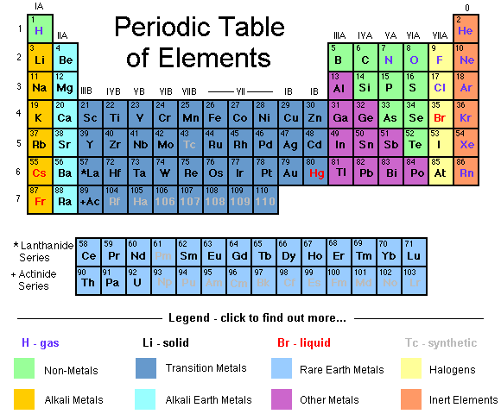
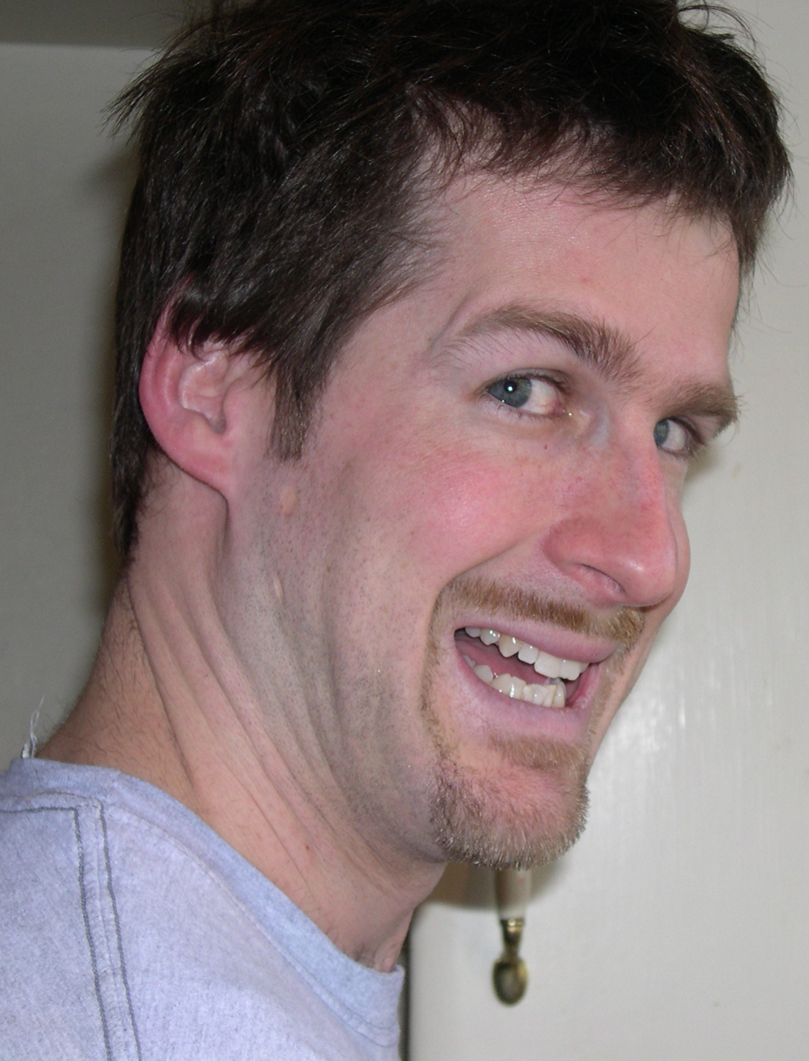
A) Evolution Requires a Universe Capable of Supporting Stable Living Organisms
Notes:
As Michael Denton describes it, in the case of the atoms there are “rules which govern the assembly of subatomic particles into atomic structures, and generate the finite set of 92 atoms which make up the periodic table of the elements,…[1]” While it is possible to make other atoms by bombarding certain naturally occurring elements with particles, these man-made atoms tend to be short lived and are of little importance when it comes to understanding evolution. [1] Denton Platonic forms pg 9.
Carbon in wood is stable. Burn it it turns to carbon in carbon dioxide. Carbon formed in stars is extremely stable and disperses when start dies.

Slide 19
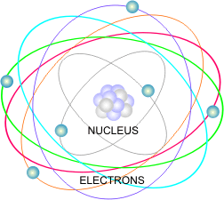
Why Do These Stable Atoms Exist?
Because of the specific nature of the subatomic particles and forces
Strong nuclear force
Proton and neutron size
Electromagnetic force
Notes:
Where does this come from→ can trace it all back to the physics. Where does the order in the physical laws, particles and forces come about.
See the order lets look at some of these that are important for the nucleus.
Somehow, all of these relationships and particles have been fine-tuned and balanced to create this rare and beautiful universe capable of sustaining and evolving life.
Strong nuclear force: holds atomic nuclei together if too small, only hydrogen would form can’t get large atoms, if too large two protons or two neutrons could stick together and this would lead to stars burning too fast, too fast for life too emerge, lack of hydrogen
Neutrons are heavier than protons, if it was the other way around protons would not be stable and you have no hydrogen, serious problem for life. Has to do with the particle (quarks) that make them up. No one knows why quarks in protons are lighter. If heavier, then they would decay into protons and not enough neutrons around for heavier elements
Electromagnetic force (controlled by fine structure constant) if larger then start to make larger elements unstable, also makes hydrogen unstable, if smaller no adequate chemical bonding

Slide 20
Order at Each Level Emerges From an Underlying Order
This order is essential for evolution to work
Notes:
What physicists have found has been beautiful ordered relationships at the subatomic level, although there is no reason that our universe, by necessity, had to be structured in this fashion. One could easily imagine a universe in which there was no standard relationship between electrons and protons, or no standard relationship between the neutrons and protons and the quarks out of which they are composed.

Slide 21
The Order of Evolution
Issue #2) Evolution is an interplay between order and chance
Order
Chemistry and physics
A) It is essential for evolution to operate.
B) It highly influences what evolution will produce via natural selection

Slide 22

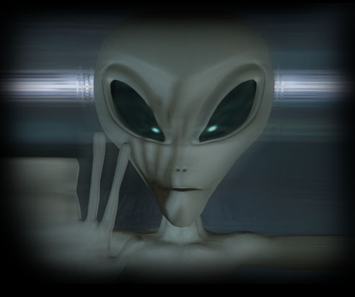
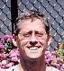
B) Chemical and physical order highly influences what evolution will produce
What would happen if you re-ran the tape of evolutionary history?
1) totally new world (Highly Contingent)
2) very similar organisms (Highly Convergent)

Slide 23
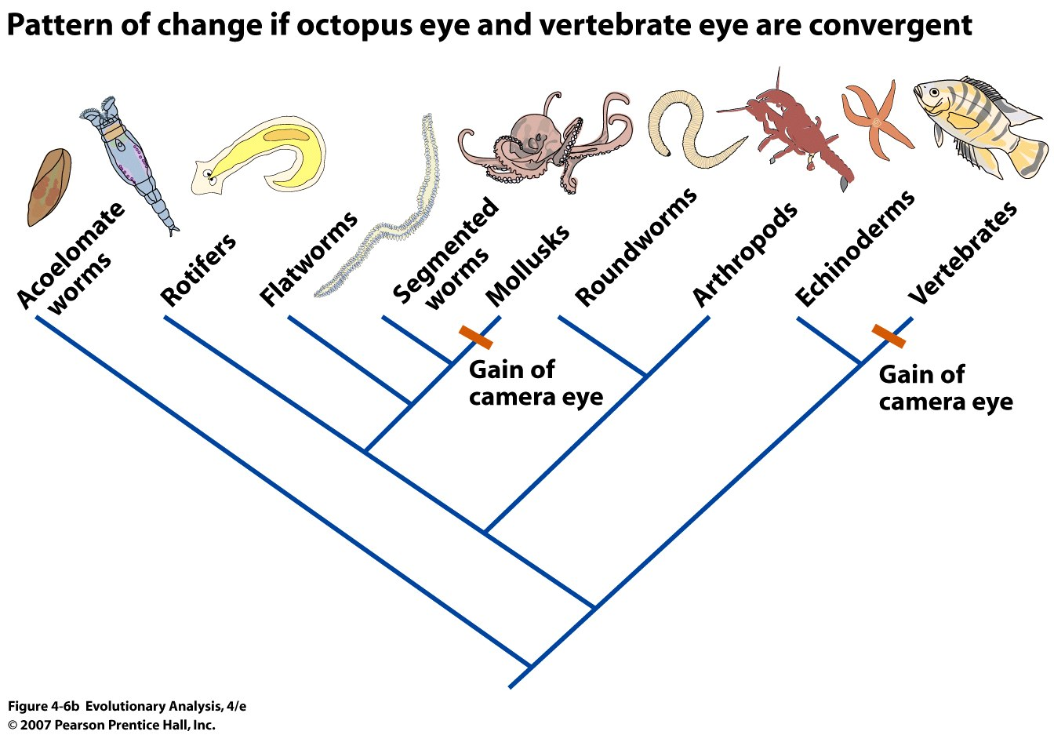
Convergence in Evolution
Features that have arisen in multiple times independently during evolutionary history
Notes:
Camera-like eye, powered flight, echolocation, bipedality, C4 photosynthesis→ 66 times independently

Slide 24
Protein Evolution
Convergence in protein evolution
Proteins are strings of amino acids bonded together
20 biological amino acids

Slide 25
Secondary Structures

Slide 26
Infinite number of primary sequences
Only two common secondary structures
All proteins converge on ~1000 protein folds

Slide 27
Evolution relies upon “chance” events. This demonstrates that the universe has no purpose, no design and no Creator
Universe is ordered at its most fundamental level. Evolution via natural selection is entirely dependent on this order and evolutionary outcomes are highly influenced by this order
Chance events help uncover this underlying order
Notes:
Evolution rather than detracting from God, draws one toward a creator relies upon an order, order that is a gift to the created world.

Slide 28
Creation and Evolution, Chance and Purpose: A Catholic Perspective
Notes:
What is Creation?
A Catholic perspective
Evolution
Science of evolution vs philosophical claims made about evolution
Overview of Church Teaching on Evolution
Theological and philosophical questions about evolution
Order and Purpose in Evolution?
Human Origins and Original Sin

Slide 29
Human Origins and Origin Sin
“Consequently each person is from the very start, damaged in relationships and does not engage in them as he or she ought.”
Pope Benedict XVI
“In the Beginning”
What can we know about this?

Slide 30
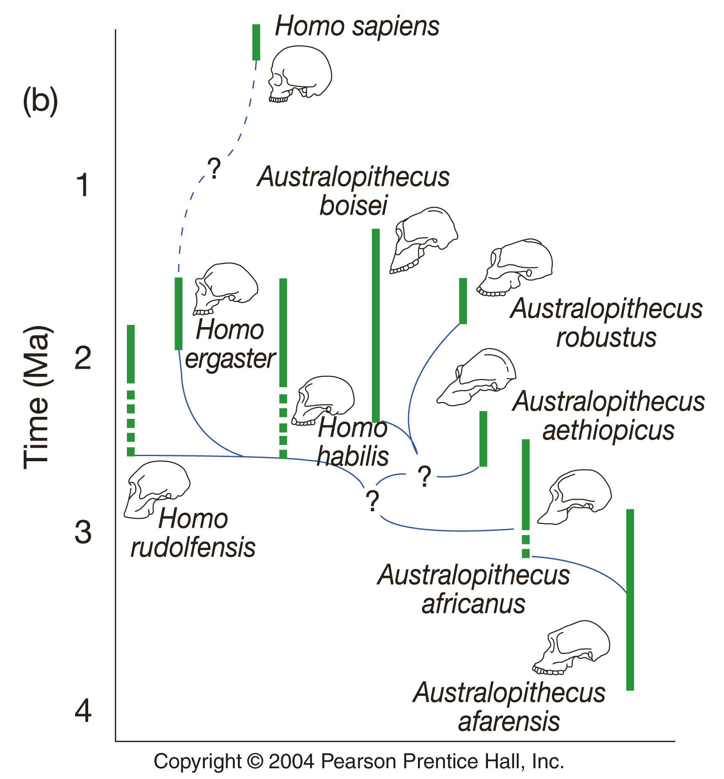
Hominin Fossils
Not a neat lineage from common ancestor of chimps and humans to modern man
Mosaic evolution
Three Phases:
The base of the hominin tree
African diversification
Waves out of Africa
Notes:
All of these are hominids, gorilla, humans and chimps are (homininae) hominin is lineage to humans
The detailed justifications for including Sahelanthropus, Orrorin and
Ardipithecus in the hominin clade vary according to what anatomical
regions are represented1–4, but three main threads run through the claims
for hominin status. The first involves a reduction in size and a change in
morphology of the canines accompanied by the partial or complete loss of
upper canine/lower third premolar (P3) honing and a reduction in the
degree of canine sexual dimorphism, associated with inferences about
social organization. The second involves the location and orientation of
the foramen magnum and inferences about upright posture, and the third
involves features of the pelvis and other preserved postcranial elements
that imply a dependence on bipedalism. In each case the assumption is
that these character complexes and their inferred behaviours are unique
and thus confined to the hominin clade.
The canine morphology that Ardipithecus and Sahelanthropus share
with later hominins is, perhaps, the most convincing evidence to support
their hominin status, but it is important to recognize that during the late
Miocene a number of Eurasian hominids (for example, Oreopithecus,
Ouranopithecus and Gigantopithecus) also developed small canines in
conjunction with reduced canine–premolar honing, presumably as a
result of parallel shifts in dietary behaviour in response to changing
ecological conditions.

Slide 31
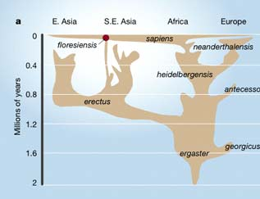
Waves Out of Africa
Recent hominins
1) Homo erectus: 0.2-2 MYA
2) Homo neanderthalensis: .03-.5 MYA
3) Homo sapiens:
Modern humans first found in Morocco (300,000 years ago) then throughout the globe (100,000 years ago)

Slide 32
What Does it Mean to Be Human?
Biologically
Theologically

Slide 33
What Does it Mean to Be Human?
“The sciences of observation describe and measure, with ever greater precision, the many manifestations of life, and write them down along the time-line.”
“The moment of passage into the spiritual realm is not something that can be observed in this way—although we can nevertheless discern, through experimental research, a series of very valuable signs of what is specifically human life.”
“But the experience of metaphysical knowledge, of self-consciousness and self-awareness, of moral conscience, of liberty, or of aesthetic and religious experience—these must be analyzed through philosophical reflection, while theology seeks to clarify the ultimate meaning of the Creator’s designs.” St. John Paul II

Slide 34
Creation and Evolution, Chance and Purpose: A Catholic Perspective
Evolution can enlighten our theological understanding of God and Creation.
Must proceed with caution and humility
Notes:
What is Creation?
A Catholic perspective
Evolution
Science of evolution vs philosophical claims made about evolution
Overview of Church Teaching on Evolution
Theological and philosophical questions about evolution
Order and Purpose in Evolution?
Human Origins and Original Sin

Slide 35
Gen 1
Gen 2
Gen 3+
Kemp, K.W. (2011) Science, Theology, and Monogenesis. American Catholic Philosophical Quarterly, Vol. 85, No. 2.

